Slide 1
Single to Double (S2D)
組員：
徐英愷 (國立成功大學)
辛宥言 (國立交通大學)
潘珠峰 (國立清華大學)
林恒卲 (國立宜蘭大學)

Slide 2
Why S2D?
Nobody wants to be lonely
Single people want to date
Improve birth rate for the economy
Get familiar with Azure
Lots of fun, why not?

Slide 3

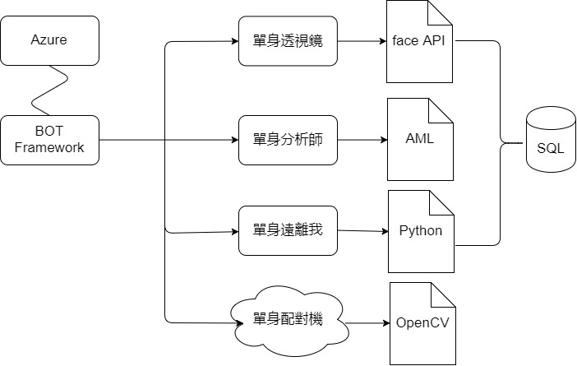






Bot Architecture
3

Slide 4
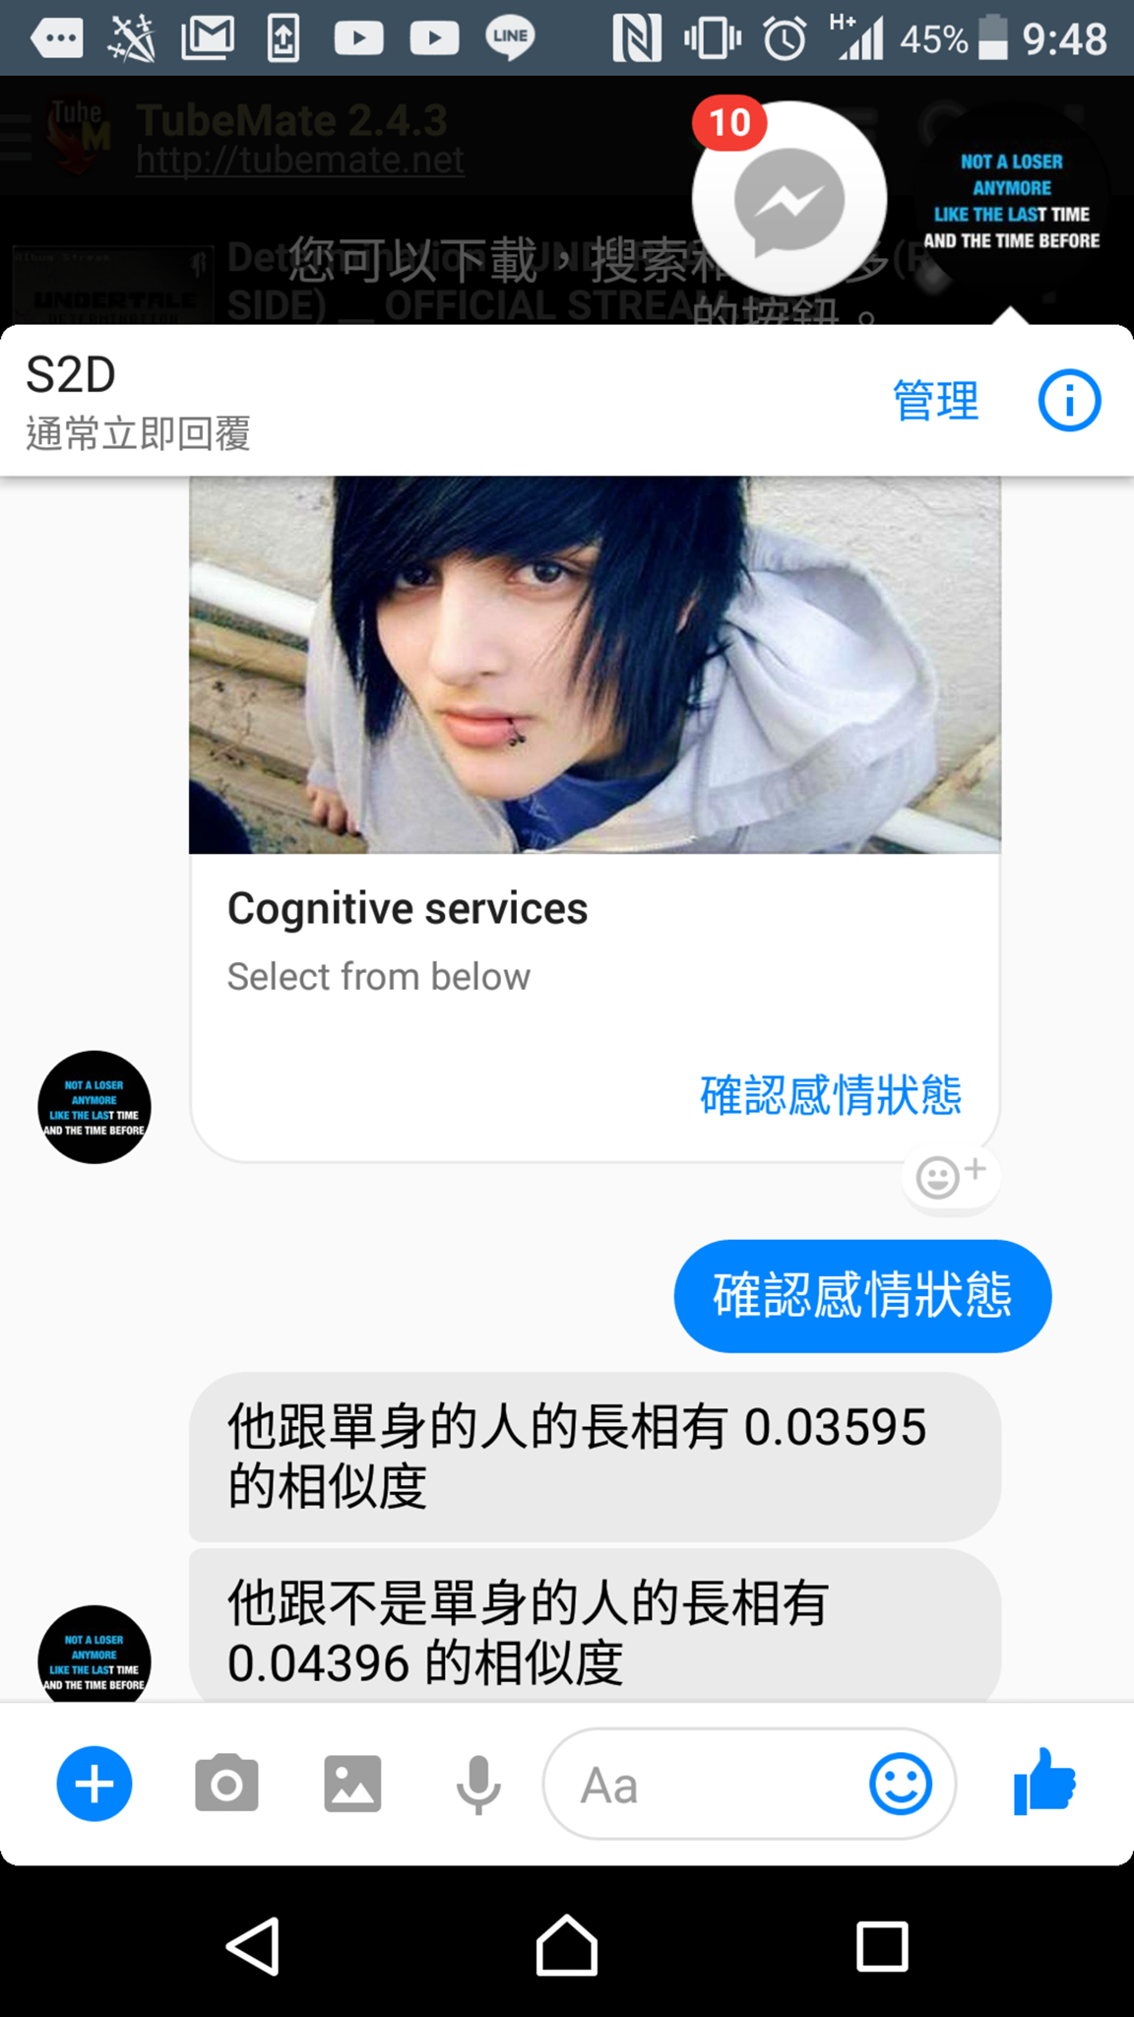
Demo
單身透視鏡

Slide 5
Demo
單身遠離我

Slide 6
Demo
單身分析師

Slide 7
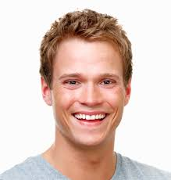
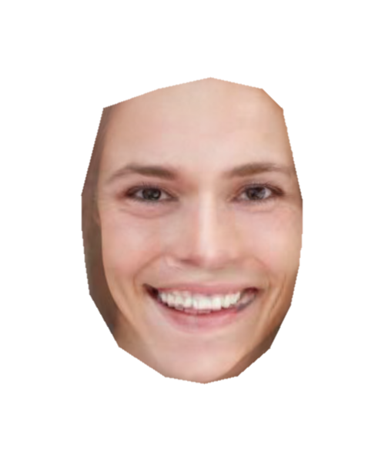
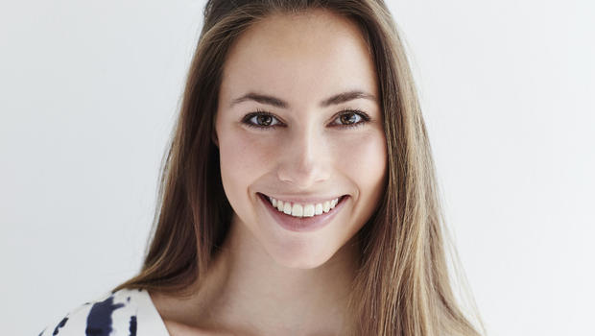
單身配對機
By face morpher:
https://github.com/alyssaq/face_morpher

Slide 8
Q & A

